Slide 1
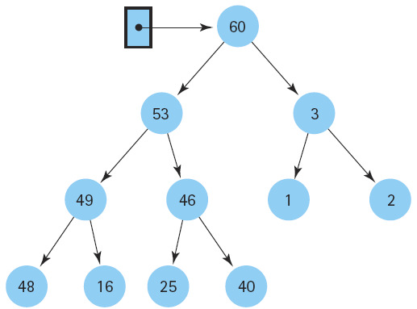
Data Structures &
Algorithms

Slide 2
Design specification on DSA
Specifying ADTs using formal notation e.g. ASN.1
What does refer to ASN.1?
- Abstract Syntax Notation One
- ASN.1 is a standard interface description language for
defining data structures that can be serialized and deserialized
in a cross-platform way.
It is broadly used in telecommunications and computer networking,
and especially in cryptography.

Slide 3
Points….
Protocol developers define data structures in ASN.1 modules, which are generally a section of a broader standards document written in the ASN.1 language.
The advantage is that the ASN.1 description of the data encoding is independent of a particular computer or programming language (other than ASN.1.)
Because ASN.1 is both human-readable and machine-readable, an ASN.1 compiler can compile modules into libraries of code, CODECs, that decode or encode the data structures.

Slide 4
Points…
ASN.1 is a joint standard of the
International Organization for Standardization (ISO), International Electrotechnical Commission (IEC), and International Telecommunication Union Telecommunication Standardization Sector (ITU-T)

Slide 5
Language support
ASN.1 is a data type declaration notation. It does not define how to manipulate a variable of such a type.
This is actually defined in other languages such as SDL(Specification and Description Language) for executable modeling or TTCN-3 (Testing and Test Control Notation) for conformance testing.
Both these languages natively support ASN.1 declarations. It is possible to import an ASN.1 module and declare variable of any of the ASN.1 types declared in the module.

Slide 6
Encodings
ASN.1 is closely associated with a set of encoding rules that specify how to represent a data structure as a series of bytes. The standard ASN.1 encoding rules include:
Basic Encoding Rules (BER)
Distinguished Encoding Rules (DER)
Canonical Encoding Rules (CER)
Packed Encoding Rules (PER, unaligned: UPER, canonical: CPER, canonical unaligned: CUPER)
Encoding Control Notation (ECN)

Slide 7
Cont…
XML Encoding Rules (XER)
Canonical XML Encoding Rules (CXER)
Extended XML Encoding Rules (E-XER)
Octet Encoding Rules (OER, canonical: COER)
JSON Encoding Rules (JER)
Generic String Encoding Rules (GSER)

Slide 8
Points….
The encoding rules are all platform-independent, and can be used across a variety of hardware and software.
The PEM format is often used to encapsulate DER-encoded ASN.1 certificates and keys in an ASCII-only format.
The PEM version of a DER message consists of the base64 encoding of the DER message, preceded by "-----BEGIN FOO-----" and followed by "-----END FOO-----," where "FOO" may indicate "CERTIFICATE," "PUBLIC KEY," "PRIVATE KEY" or many other types of content.

Slide 9
Example
This is an example ASN.1 module defining the messages (data structures) of a fictitious Foo Protocol:
FooProtocol DEFINITIONS ::= BEGIN
FooQuestion ::= SEQUENCE {
trackingNumber INTEGER,
question IA5String
}
FooAnswer ::= SEQUENCE {
questionNumber INTEGER,
answer BOOLEAN
}
END
This could be a specification published by creators of Foo Protocol.
Conversation flows, transaction interchanges, and states are not defined in ASN.1, but are left to other notations and textual description of the protocol.

